Slide 1
Applications on Azure: Putting All the Pieces Together
James Chambers | Software Engineer, Microsoft MVP
Simon Timms | Software Engineer, Microsoft MVP

Slide 2

Meet James Chambers | ‏@CanadianJames
Senior Software Engineer
Background in healthcare, telecom, transportation ++
Currently focusing on building things that scale
Author, Speaker Mentor
Founding member of Western Devs
Frequent contributor to user groups, brown bags and conferences
Four-time ASP.NET/IIS MVP

Slide 3
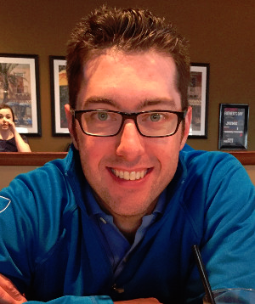
Meet Simon Timms | ‏@stimms
Senior Software Engineer
Spent years working on Linux, Unix and even z/OS
Lots of oil and gas experience
Author, Speaker Mentor
Founding member of Western Devs
Calgary .net User Group
2nd time MVP in ASP.net

Slide 4
Course Topics
Applications on Azure: Putting All the Pieces Together
01 | Intro | 05 | Storing Data and Objects in Azure
02 | Exploring Application Architecture | 06 | ElasticSearch, Docker and YOU
03 | Working with Azure DNS Services | 07 | Scaling Your Application Under Load
04 | Executing Large Tasks in the Cloud | 08 | Rewind

Slide 5
Setting Expectations
Please leave this area blank to allow for picture in picture recording
Target Audience
People who know about computers
Developers. Could be .net but for most of this stuff it doesn’t matter
Suggested Prerequisites/Supporting Material
Rudimentary knowledge of Azure
Some understanding of distributed systems

Slide 6

Regions
Please leave this area blank to allow for picture in picture recording
Notes:
These are all the regions
5 in the US, + two government ones
Two in Europe
Hong kong
singapore
2 in japan
Brazil
2 in Australia
3 in india
Coming 2 in Canada some time in 2016 Toronto and Quebec City

Slide 7
PaaS, SaaS, IaaS,
Please leave this area blank to allow for picture in picture recording
Notes:
Aardvark, aardwolf, bazaar all other words with two As in them
Hanselman’s explination of taxi, rental car and owning a car

Slide 8
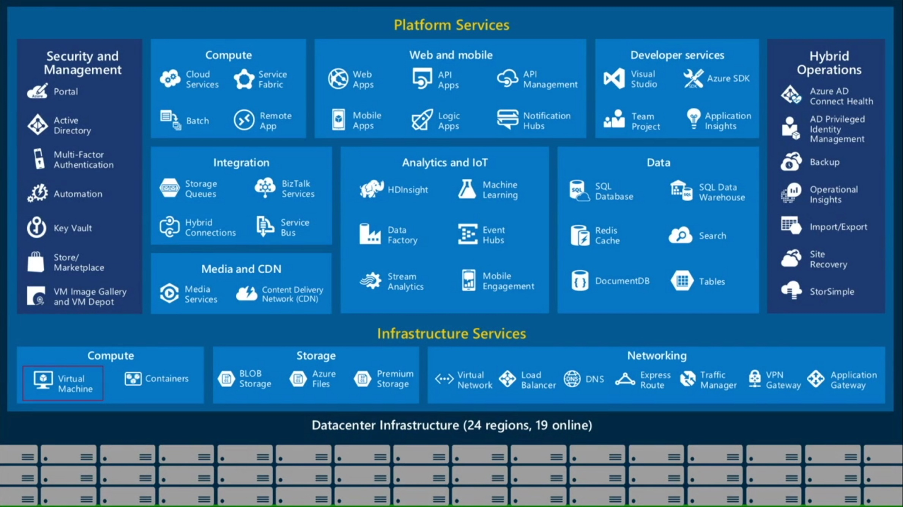
Azure is All Things
Please leave this area blank to allow for picture in picture recording

Slide 9
Bits of Azure
Please leave this area blank to allow for picture in picture recording

Slide 10
Recommended Reading
Please leave this area blank to allow for picture in picture recording
https://azure.microsoft.com/en-us/documentation/articles/fundamentals-introduction-to-azure/

